Slide 1

Moving to RISC-V Vector - A Practical Journey of AI Operator Optimization
Guodong Xu,
RISCstar Solutions
Notes:
Hello, Santa Clara! Hello, everyone!
Welcome to my session. Today we are talking about using RISC-V Vector instructions in ‘AI’ Operator development.
We all have the vision that performance demands of modern AI inference at the edge side is MASSIVE.
Then, how can we achieve more gains with the RISC-V Vector extensions?
Today, I will share my thinking based on benchmarks I captured over these AI operators.

Slide 2



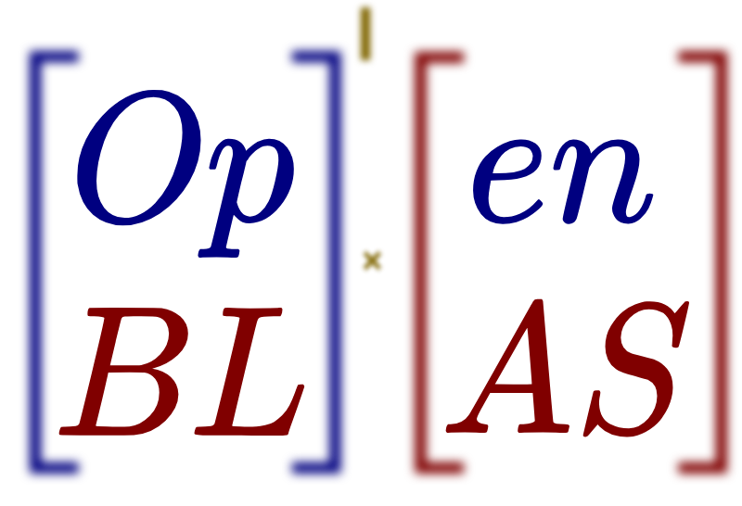


Who Am I ?
GUODONG XU
Chief Engineer,
Director of China Operations
RISCstar Solutions
Intel® ISA-L Library
BLIS
Notes:
My name is Guodong Xu, coming from RISCstar Solutions.
RISCstar is RISC-V software ecosystem company, founded last year by ex-leader of Linaro (which you may know, is a Arm-software ecosystem company).
In RISCstar, we all have a vision to speed up and consolidate RISC-V software.

Slide 3
Agenda & Goals
Let's explore RISC-V Vector (RVV)'s practical application and performance by analyzing its implementation in two key open-source libraries: OpenBLAS (linear) and SLEEF (nonlinear).
Part 1: Analyze the design logic for RVV in contrast to its Original Vector Code counterpart.
Part 2: Compare RVV implementations side-by-side with code snippets.
Part 3: Demonstrate vectorization speedup (Vector vs. Scalar) on RVV.
Part 4: Share practical tooling insights using the perf utility.
A Note on Performance: We will focus on the speedup ratio within each architecture. Direct cross-ISA performance is not compared due to differing hardware settings
Notes:
Today, let’s focus on two open-source libraries: OPENBLAS and SLEEF.
1st, First, I will explain the design logic of using RVV
I will show the actual RVV code / assembly, intrinsics / we used in these kernels.
2nd, I will show the performance gains we can achieve using RVV, I made comparison between scalar and vector.
IMPORTANTLY, which I’ll elaborate later, I made comparison between different RVV VECTOR configurations.
3rd，I’ll touch a little bit of ‘Observability and tooling’, like PERF, but due to today’s session length, I won’t speak much.

Slide 4
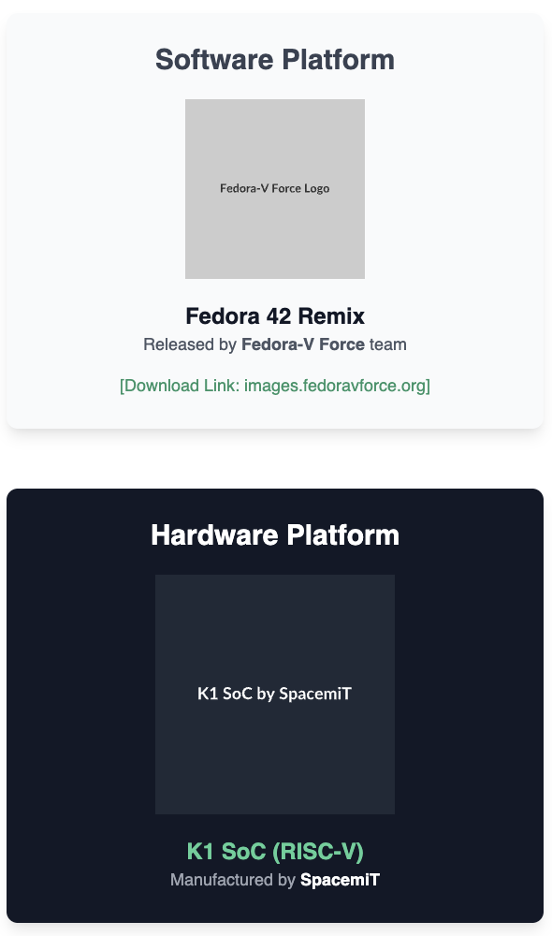
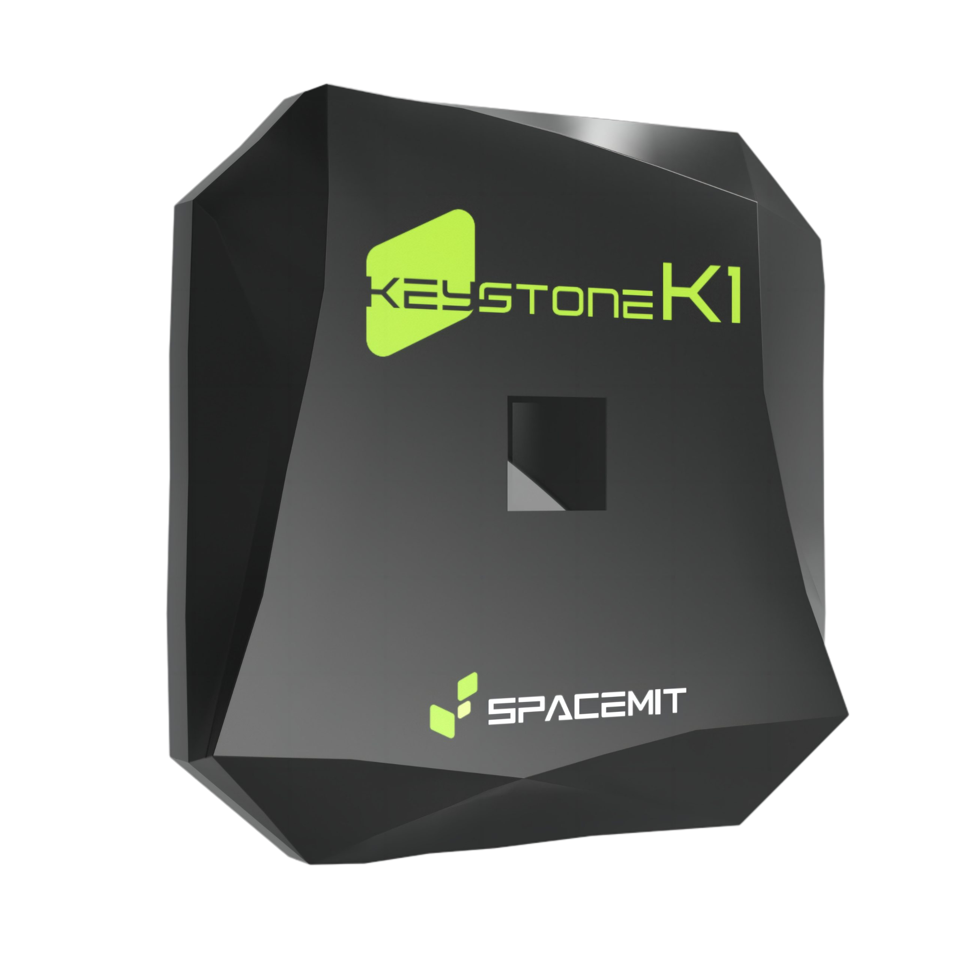


Performance Measurement Environment & Toolchain
RISCstar Toolchain
Built by experts with cross-architecture fluency, our toolchain is finely tuned for maximum performance on RISC-V Vector hardware.
Explore Now:
https://riscstar.com/toolchain/
Special thanks to from the Fedora-V Force team, who provided invaluable support in conducting the performance measurement in OpenBLAS and using Perf.
Mr. Haibin Liu
Notes:
A quick list of environment I used for performance measurement I’ll present in this talk.
Hardware side, it’s SpacemiT’s K1 SoC, which is a RVV capable, with 256-bit vector length, 8 cores.
Software platform, I used a ‘Fedora 42 Remix’, released by Fedora-V Force team.
A special thanks to Haibin Liu of the Fedora-V Force team.
He provided invaluable support throughout this project.
Fir TOOLCHAIN, RISCstar builds high performance RISC-V Vector optimization tuned toolchain.
You are welcomed to download and give it a try. Leave your thoughts to us.

Slide 5
__PART I__
RISC-V Vector: Considerations when Porting
Notes:
So, Let’s jump start from KEY CONSIDERARTIONS when porting a kernel from other ISA technology to RISC-V Vector.

Slide 6
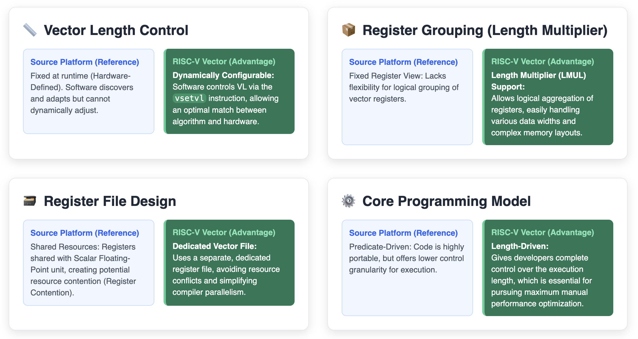
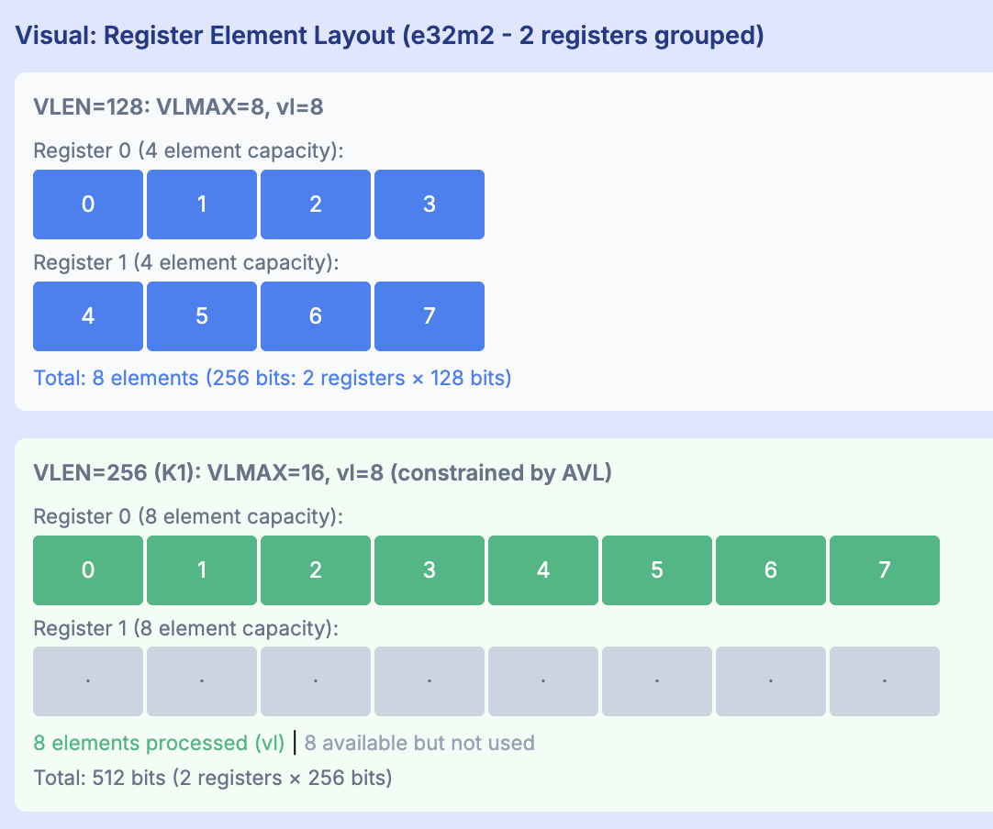
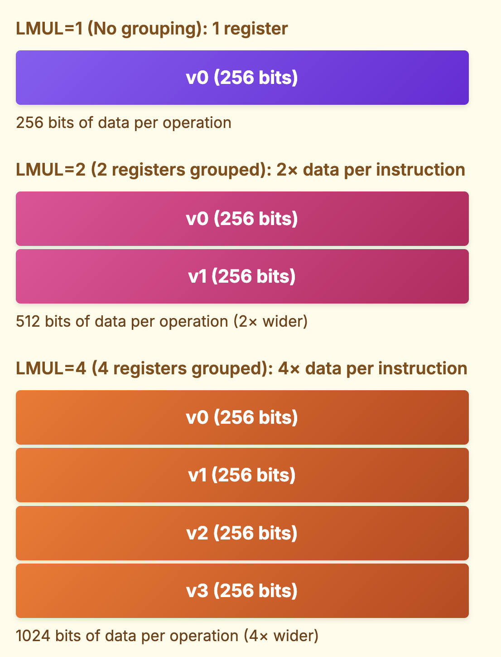
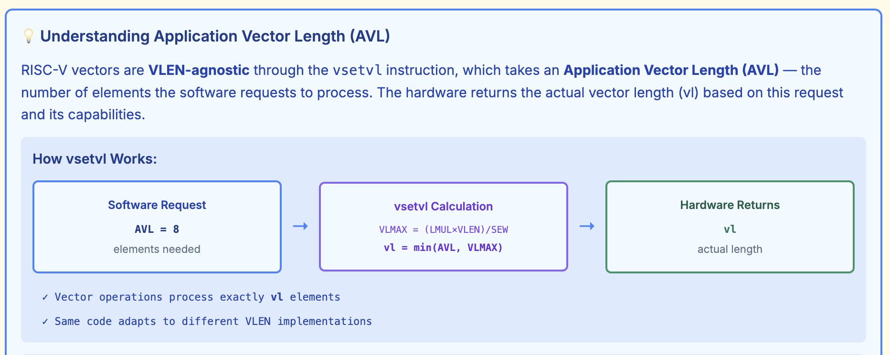
Key Architectural Design Contrasts: RISC-V Vector vs. Source Platform
Notes:
RISC-V Vector has a series of UNIQUE features comparing with other ISAs.
1st, ‘Register File Design’: risc-v provides a separate, dedicated vector register file, v0 to v31. Not overlapping with float registers (f0 to f31).
2nd, ‘Core Programming Model’: I will cover in the next page.
Let’s discuss ‘Register Grouping (Length Multiplier)’ and ‘Vector Length Control’ here in detail.
These two features are usually the first hurdles people me when they start moving from the original ISAs to RISC-V Vector.
‘Click’
Here is an illustration of the concept of ‘Register Grouping’. (i.e. LMUL, length multiplier).
This setting will group the registers into one, and name them (reference them) at the first register in the group.
Here as example, I used 256 bits vector length as example. When you set LMUL=1, you get 256bits; when you set LMUL=2, your gets 512 bits per data operations;
With LMUL=4, you get 1K bits per data operations, a total of 4 base registers.
So, How will this work in reality? That will lead us to another important concept in RVV: the ‘AVL’, ‘APPLICATION Vector Length’.
‘Click’
With register grouping (LMUL), your vector lengths can be doubled or quadrupled, or octupled (depending the LMUL you choose , 1, 2, 4, 8 is allowed), we call that ‘VLMAX’.
Basically, VLMAX equals ‘vector length’ times ‘length multiplier’. (VLMAX = VLEN * LMUL)
Then, in application, the user set the ‘AVL’, application vector length.
AVL, can be understanded as a user’s requirement. With AVL, you tell the hardware, how many elements you expect it to handle in each operation.
The hardware can say ”ok, you need 100, but in one instruction, I can only handle 16”, the hardware will return 16. (vl = 16)
In a different story, usually at the end of a loop, you can say “I want you process 11 elements”, the hardware can say “I can handle 16, but you only need 11”, the hardware will return 11 (in vl) in this case.
VL is the ‘negotiation result’ between application and the hardware.
Requirement, Negotiation, Rssponse: AVL, LMUL, and VL, all these are done in ONE RISC-V instruction: vsetvl
AVL: software’s request
VLMAX: hardware’s capability
VL: hardware’s response
The application specifies AVL, and the hardware responds by setting vl (vector length) - the actual number of elements that will be processed per iteration.
==END==
Key Point: The same kernel binary runs on all hardware, but the actual vector length (vl) is determined by both the software's request (AVL) and the hardware's capability (VLMAX). The hardware can only provide what the software asks for, even if it's capable of more.

Slide 7
Code Comparison: VL-Agnostic Philosophy
Step 1: Loop Control
Loop control: svcntw() vs returned vl.
Guarding work: predicate operand bundles (SVE) vs masked vector results using explicit vl (RVV masks only when needed).
Code impact:
- SVE keeps vector math “clean”, but demands predicated variants (svmla_f32_m);
- RVV keeps operations non-predicated but requires explicit length plumbing (__riscv_vfmacc_vv_f32m1).
Source Platform / Original Vector Code (predicate-driven) VL discovery is implicit. Loop advances using svcntw(). Per-iteration predicate pg = svwhilelt_b32(i, n) drives every instruction. Early exits (denormals, special cases) use svptest_any + svcompact to segregate active lanes. | RISC-V RVV (length-driven) Loop front-loads vl = __riscv_vsetvl_e32m1(n - i). vl controls both loop increment and each RVV intrinsic. Tail shrinks naturally via smaller vl; no predicates, but special handling uses vmslt_vx_ + __riscv_vcompress.
for (int i = 0; i < n; i += svcntw()) { svbool_t = svwhilelt_b32(i, n); svfloat32_t x = svld1(pg, &input[i]); // polynomial under pg svmla_f32_m, etc. svst1(pg, &output[i], acc); } | for (size_t i = 0; i < n; i += vl) { size_t = __riscv_vsetvl_e32m1(n - i); vfloat32m1_t x = __riscv_vle32_v_f32m1(&input[i], vl); // polynomial using __riscv_vfmacc_vv_f32m1, etc. __riscv_vse32_v_f32m1(&output[i], acc, vl); }
pg
vl
The core shift is from a predicate-driven model to an explicitly length-driven model.
Notes:
For AI operator kernels, Loop vectorization is very common.
When porting such kernel codes from the source ISA to RVV, the first step to transform MUST be the “loop control”.
I define ‘Loop Control’ modification as code porting “STEP 1”
In Arm SVE, the loop control is done by predicate. Where in each loop, a predicate must be calculated first, and this predicate (‘PG’ in the chart) will be used in every following intrinsics.
As a contrast, In RVV,
RVV uses the ‘hardware returned’ VL (vector length). And ‘VL’ will guard through the loop body, to control which lanes are used, and which lanes are not.
Both SVE and RVV, have tail-loop handled in the final iteration. The same loop code can handle partially activated vector lanes automatically.
Prototype: svfloat32_t svmla_f32_m(svbool_t pg, svfloat32_t acc, svfloat32_t x, svfloat32_t y);
Semantics:
• For lanes where pg is true: result = acc + x * y
• Else: result = acc
Prototype: vfloat32m1_t __riscv_vfmacc_vv_f32m1(vfloat32m1_t vd, vfloat32m1_t vs1, vfloat32m1_t vs2, size_t vl);
• Semantics: for i in [0, vl) do fused multiply-add• vd[i] = vd[i] + vs1[i] * vs2[i]
Notes: m1 means LMUL=1. Masked/tail variants exist: m, _tu, _tum, _tumu, _mu.

Slide 8


Practical Guide: Key Porting Steps & Common Pitfalls
Step 2: Key Intrinsic & Concept Mapping
Operation | Original Vector Intrinsics | RISC-V RVV Equivalent
Vector Load | svld1(pg, &ptr[i]) | __riscv_vle32_v_f32m1(&ptr[i], vl)
FMA | svmla_f32_m(pg, acc, x, h) | __riscv_vfmacc_vv_f32m1(acc, x, h, vl)
Horizontal Sum | float result = svaddv_f32(svptrue_b32(), acc_vec); | v_res = __riscv_vfredusum_vs_f32m8_f32m1(acc, v_res, vl); // Extract scalar result float result = __riscv_vfmv_f_s_f32m1_f32(v_res);
Segmented Load / Structured Load | svld3_u8(pg, base) (up to 4 fields) | vlseg3e8.v v8, (rs1), vm (up to 8 fields)
, where the list can be very long !
Recommended Resource for Deep Dive
For a comprehensive guide on intrinsic mapping and porting methodology, consider the upcoming NEW COURSE: Porting Software to RISC-V (LFD 114). This training is developed to provide the cross-architecture fluency needed for real-world application porting.
Notes:
Identified the ‘main loop’ of a kernel implementation, the NEXT STEP in porting is likely the ‘Intrinsics’ and ‘Concept’ mapping.
From the original vector instinsics TO the RVV equivalent.
Major operations in SVE, most of them, have direct mapping to RISV-V RVV.
You just need to map and replace with the right RVV equivalent.
Here, what I put, is just some examples.
One very good example for doing such mapping is to check the implementation of kernels in SLEEF.
SLEEF is designed with common C (simdsp.c or simddp.c) source code, but using ‘architecture’ specific header file to map the common code to difference architectures.
It can support Intel AVX, Arm SVE, and RISC-V Vector.
For NOW, I would like to recommend a new course developed together by RISCstar and the LINUX FOUNDATION.
I suggest that any serious developer who want to learn more about this porting, take the online course. LFD114.
It will be live online soon.

Slide 9
__PART II__
AI Inference Operators
Notes:
Enough elaborations about RISC-V vector instructions and intrinsics, NEXT, let’s move on to AI Inference Operators.

Slide 10
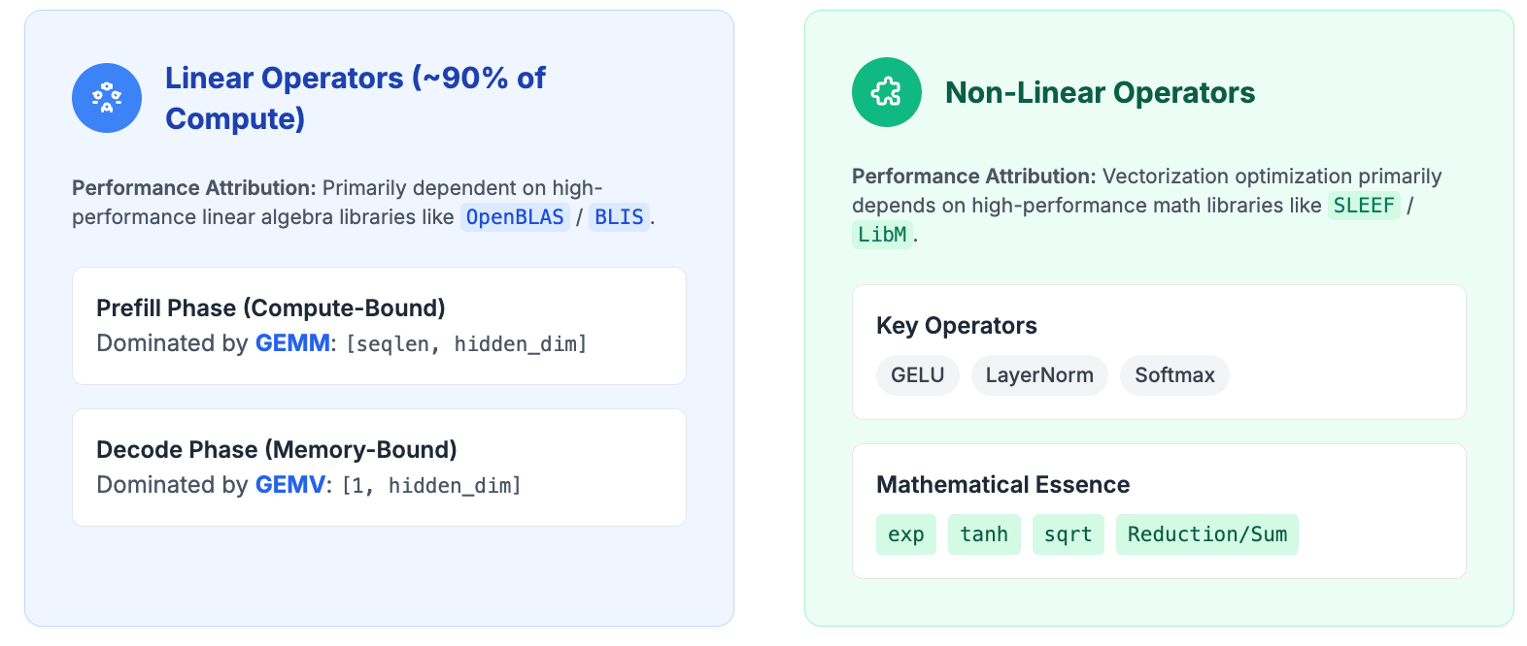
AI Inference Operators
Our analysis focuses on the core bottleneck of LLM Inference: the Transformer Block. Its workload can be broken down into two main operator categories:
Notes:
In AI inference side, the majority part of the computing can be categorized into two groups:
1. is the Linear-Algebra Operators, such as
Matrix-Matrix Multiplication ‘GEMM’ in the prefill phase;
Matrix-Vector Multiplication in the decode phase. ‘GEMV’
These two operators are ‘COMPUTE-BOUND’ and ‘MEMORY-BOUND’ respectively.
2nd group is the Non-Linear Operators.
Key operators include:
ACTIVATION functions, like GeLU.
NORMALIZATION functions, like LayerNorm. Layer Normalization (LayerNorm) is a technique that stabilizes neural network training by normalizing the inputs to a layer independently for each data sample.
CLASSIFIER functions, lik Softmax. Softmax is a mathematical function that converts a vector of numbers into a probability distribution, where the outputs are between 0 and 1 and sum to 1.
Underlining these non-linear operators, are math libraries, including exp (exponent), tanh (hyperbolic tangent), sqrt, and reduction ops.

Slide 11
__PART III__
Linear Operator Deep Dive (OpenBLAS)
Notes:
Let’s start from LINEAR-ALGEBRA operators.

Slide 12
The OpenBLAS RVV Strategy: "Fixed Small VL" for Cache Efficiency
The OpenBLAS implementation for RVV reveals a critical engineering trade-off that prioritizes cache efficiency for compute-bound tasks.
BLAS1/2 (e.g., GEMV, axpy):
Strategy: Dynamic VL.
Implementation: Uses vsetvl to set VL to the number of remaining elements, making full use of the hardware's VLEN.
Use Case: Ideal for Memory-Bound operations to maximize memory bandwidth.
BLAS3 (MatMul Micro-kernels):
Strategy: Intentionally uses a Fixed Small VL (e.g., VL=4 or 8).
Implementation: DYNAMIC_ARCH is used to compile specialized kernels for targets like ZVL128B and ZVL256B. Even on hardware with a wider VLEN, the kernel intentionally constrains VL.
Engineering Goal: To ensure the micro-kernel's tile size perfectly matches the L1 Cache, sacrificing VLEN utilization for maximum data locality. This is the key to performance in Compute-Bound tasks.
Notes:
For Linear-Algebra, OpenBLAS is the most popular open-source solution. It has been integrated into many AI inferencing frameworks.
My evaluation of RVV on linear-algebra starts from OpenBLAS.
Generally, the BLAS APIs are divided into THREE levels.
Level-1 and Level-2: are vector-vector (dot-product), matrix-vector (like GEMV) operations.
The nature of Level 1 and 2 APIs, is they are ‘memory-bound’, and as a result of this, the implementation should try to use the MAXIMUM AVAILABLE vector length.
Here it comes to an interest point that IF with enough ‘memory’ bandwidth, should we maximize the register grouping ie. LMUL? (1, 2, 4, 8)
Level-3: are matrix-matrix (like GEMM) operations.
The nature of GEMM is very ‘compute-bound’, with o(n) of data movement, computing between them are the order of square o(n²).
Theoretical constraints to kernel design GEMM are two major:
1. half of the available registers are used for storing the UNROLL-ING of (m*n) submatrix.
2. the size L1-cache.
In the implementation of today’s OpenBLAS, a ‘DYNAMIC_ARCH’ is introduced to cope different targets with VLEN. 128bits and 256bits.
They can all be built into one binary, and chose the correct kernel at runtime.
axpy: alpha times x plus y

Slide 13
Code Comparison: SGEMM Core Computation (K-Loop Inner Body)
Source Platform Original Vector Code (predicate-driven) kernel/arm64/sgemm_kernel_sve_v1x8.S (874 lines) | RISC-V RVV (length-driven) kernel/riscv64/sgemm_kernel_8x8_zvl128b.c (791 lines)
; Software-pipelined, 2x unrolled K-loop .macro KERNELv1x8_M1 ld1w z1.s, p1/z, [pA] ; Load A[k+1] for next iter add pA, pA, lanes, lsl #2 ; Advance A pointer ; Compute with A[k] (z0), load B[k+1] for next iter fmla z16.s, p1/m, z0.s, z8.s ; acc0 += A[k] * B[k,0] ld1rw z8.s, p0/z, [pB] ; Broadcast B[k+1,0] fmla z17.s, p1/m, z0.s, z9.s ; acc1 += A[k] * B[k,1] ld1rw z9.s, p0/z, [pB, 4] ; Broadcast B[k+1,1] fmla z18.s, p1/m, z0.s, z10.s ; acc2 += A[k] * B[k,2] ld1rw z10.s, p0/z, [pB, 8] ; Broadcast B[k+1,2] fmla z19.s, p1/m, z0.s, z11.s ; acc3 += A[k] * B[k,3] ld1rw z11.s, p0/z, [pB, 12] ; Broadcast B[k+1,3] fmla z20.s, p1/m, z0.s, z12.s ; acc4 += A[k] * B[k,4] prfm PLDL1KEEP, [pA, #A_PRE_SIZE] ; Prefetch A ld1rw z12.s, p0/z, [pB, 16] ; Broadcast B[k+1,4] fmla z21.s, p1/m, z0.s, z13.s ; acc5 += A[k] * B[k,5] ld1rw z13.s, p0/z, [pB, 20] ; Broadcast B[k+1,5] fmla z22.s, p1/m, z0.s, z14.s ; acc6 += A[k] * B[k,6] ld1rw z14.s, p0/z, [pB, 24] ; Broadcast B[k+1,6] fmla z23.s, p1/m, z0.s, z15.s ; acc7 += A[k] * B[k,7] ld1rw z15.s, p0/z, [pB, 28] ; Broadcast B[k+1,7] add pB, pB, 32 ; Advance B pointer .endm | // Simple K-loop, compiler handles scheduling for (BLASLONG k = 1; k < K; k++) { // Load 8 scalars from B float B0 = B[bi + 0]; float B1 = B[bi + 1]; float B2 = B[bi + 2]; float B3 = B[bi + 3]; float B4 = B[bi + 4]; float B5 = B[bi + 5]; float B6 = B[bi + 6]; float B7 = B[bi + 7]; bi += 8; // Load vector from A (8 elements @ zvl128b) vfloat32m2_t A0 = __riscv_vle32_v_f32m2(&A[ai], gvl); ai += 8; // 8x vector-scalar FMA: acc += A * B (scalar broadcast implicit) result0 = __riscv_vfmacc_vf_f32m2(result0, B0, A0, gvl); result1 = __riscv_vfmacc_vf_f32m2(result1, B1, A0, gvl); result2 = __riscv_vfmacc_vf_f32m2(result2, B2, A0, gvl); result3 = __riscv_vfmacc_vf_f32m2(result3, B3, A0, gvl); result4 = __riscv_vfmacc_vf_f32m2(result4, B4, A0, gvl); result5 = __riscv_vfmacc_vf_f32m2(result5, B5, A0, gvl); result6 = __riscv_vfmacc_vf_f32m2(result6, B6, A0, gvl); result7 = __riscv_vfmacc_vf_f32m2(result7, B7, A0, gvl); }
Vector Load
Scalar Broadcast
Vector-Scalar FMA
p1/m
vs.
gvl
Predication
Notes:
Here is a side-by-side comparison of instructions / intrinsics of ARM’s SVE and RISC-V RVV.
More specifically, we are comparing how they handle SGEMM micro-kernel.
First, we discuss Dimension: (same N=8, output columns)
SVE uses ‘VL x 8’, it’s runtime adaptive. (at the same VLEN 128bit, SVE processes only ‘4x8’ half of the size procesed in RVV.
RVV uses 8 x 8, and it’s compile-time fixed. It accounts exactly half of the available registers in a RVV 128bit length risc-v core.
Seconds, we notice that: LMUL
RVV uses ‘Length Multiplier’ of 2 to increase the number of elements processed during each INSTRUCTION.
Third, we notice that: PREFETCH
SVE uses a lot of ‘PREFETCH’. When computing for this iteration, it pre-fetch data for next iterations.
In RISC-V, ‘Catch-Block Prefetch’ extension: Zicbop is optional (mandatory in RVA22 and RVA23). However, it is NOT in use in current OpenBLAS design.
It’s hardware implementation dependent, as well.
Let’s examine the SGEMM 8x8 implementation on both SVE and RVV to see their difference.
RVV: kernel/riscv64/sgemm_kernel_8x8_zvl128b.c (791 lines)
SVE: kernel/arm64/sgemm_kernel_sve_v1x8.S (874 lines)
TODO: A side-by-side comparison of code screenshots would be displayed here.
TODO: add connections between ‘same’ or ‘similar’ instructions

Slide 14
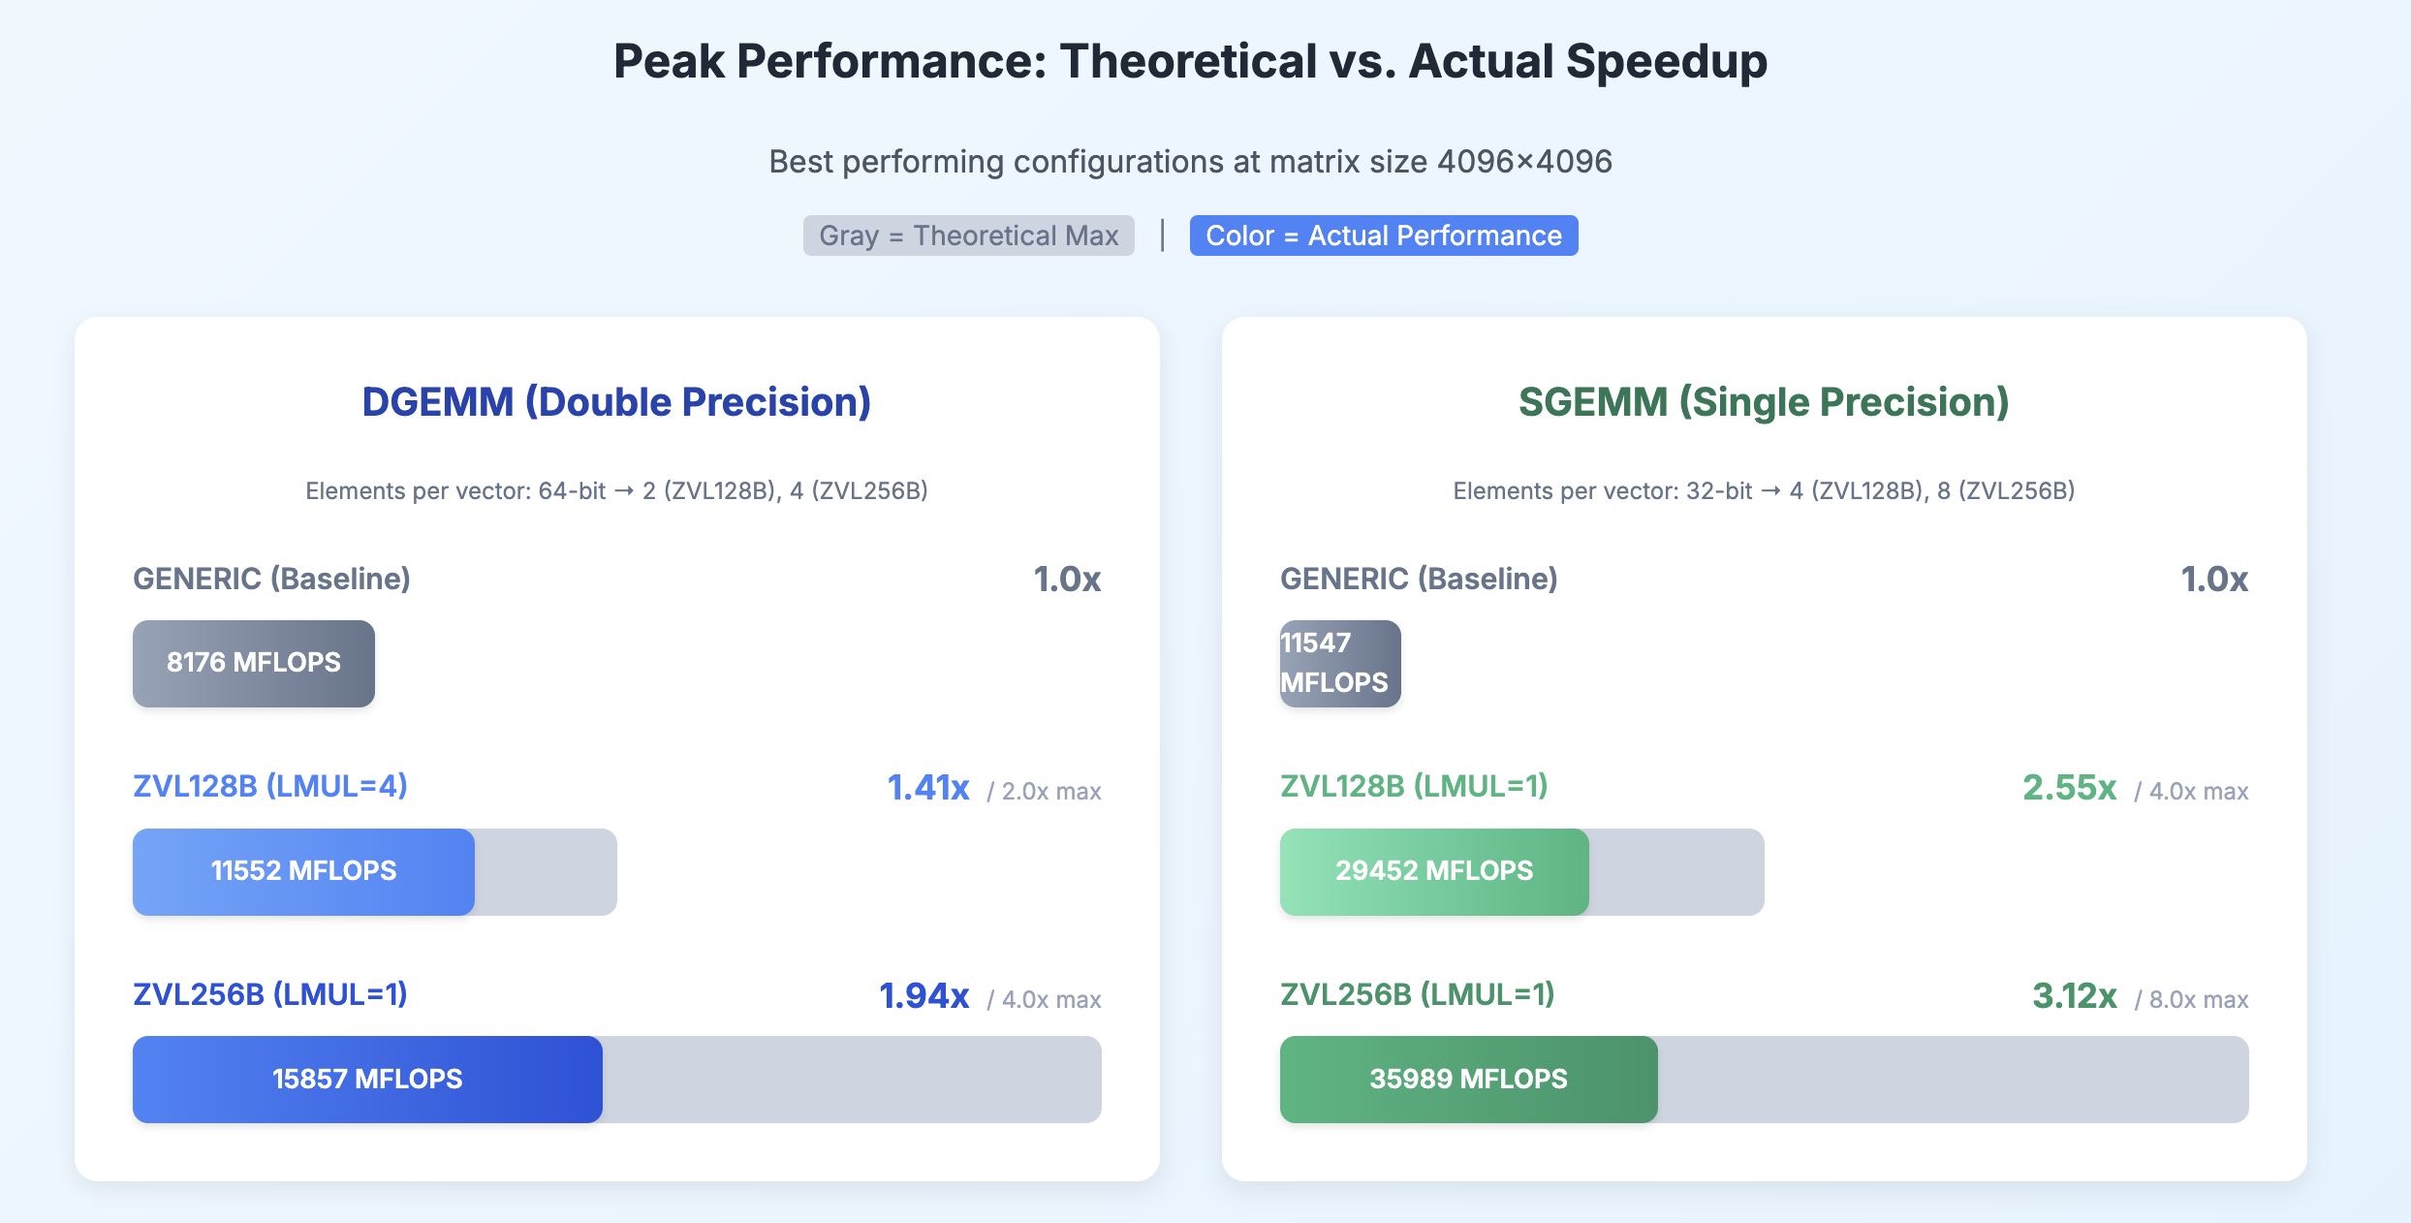
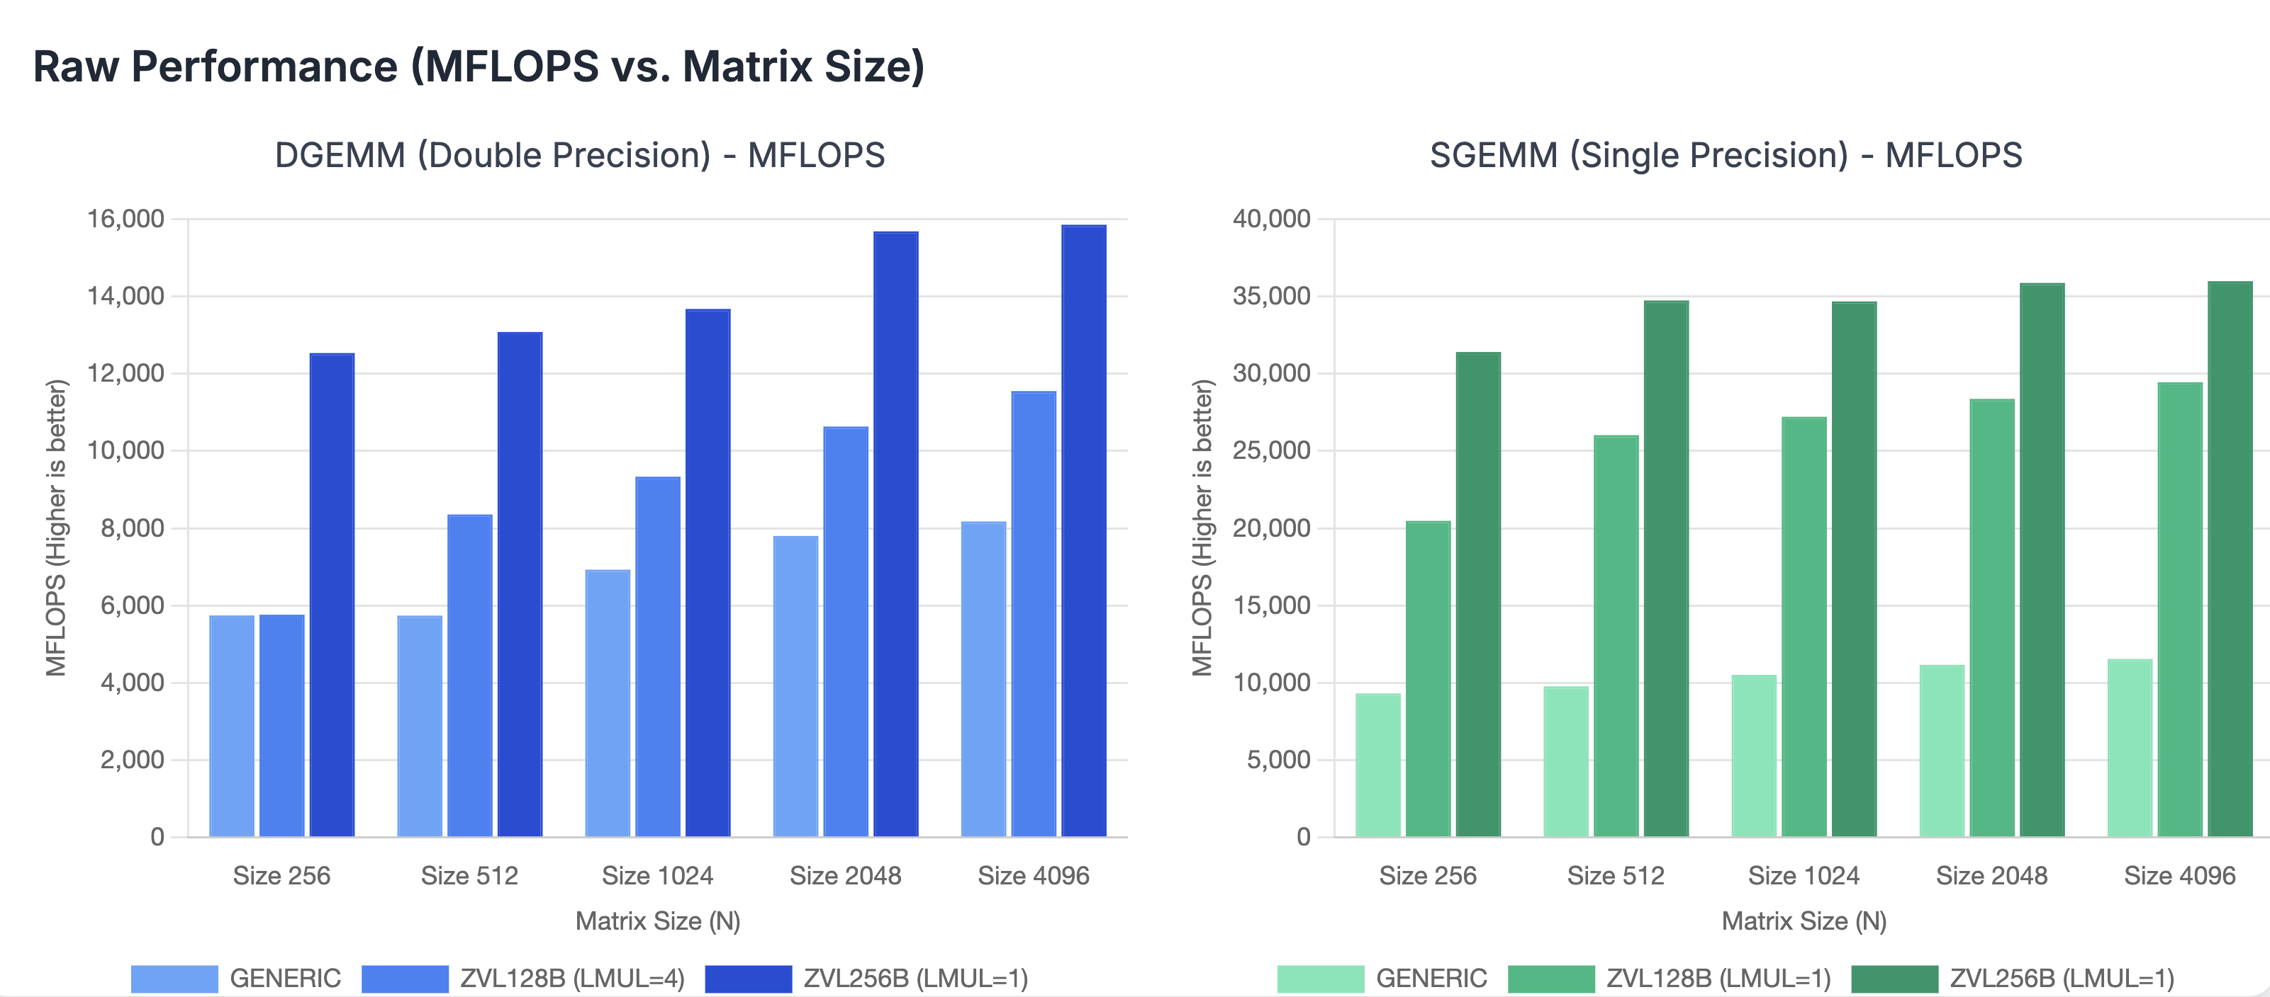
GEMM Performance Comparison & Attribution
For RISC-V, key observation points are to see what’s the impact of the two:
VLEN (Vector Length)
Wider is Better: Yes or No?
LMUL (Vector Register Grouping, aka. Length Multiplier).
How much gains can we get when increasing LMUL from 1 to 2?
Note:
GENERIC means RISC-V Scalar
ZVL128B means RISC-V Vector 128bit VLEN
ZVL256B means RISC-V Vector 256bit VLEN
For Reference, the Benchmark Testing Framework for OpenBLAS: https://github.com/docularxu/OpenBLAS/tree/working.riscv64.optimizations
Raw data and infographic published here: https://docularxu.github.io/OpenBLAS/webpages/rvv_benchmark_openblas_16Oct2025.html
Notes:
With that in mind, I compared the GEMM performance of RVV on both Double precision float and Single precision float.
The comparison is among three configurations:
Generic: being the scalar implemantion
ZVL128B: which is for hardware with 128bit Vector Length
ZVL256B: for 256bit Vector Length.
Two OBSERVATION points:
VLEN: wider is better, or not?
LMUL: bigger is better, or not?
Let’s examine vector length first. We can see from the ‘RAW PERFORMANCE’ (MFLOPS charts), that with wider Vector Length, the overall MFLOPS is bigger. That’s within expectation.
What’s to improve:
Considering ‘Theoretical speedups’, 128b Double should be 2x; 256b should be 4x times. In effect, we only achieve 1.4x and 2.0x each. With ZVL128B seems more efficient.
And in Single precision, we achieve 2.55x and 3.12x for single precision.
Which means: DGEMM achieves ~48% of theoretical peak, while SGEMM achieves ~39% of theoretical peak.
1. Practical vs. Theoretical: Performance Gap, Current RVV implementations achieve only 39-48% of theoretical peak
Reasons lies in: memory bandwidth limitations, register pressure, and other architectural constraints.
📊 Key Insight: The gray bars show theoretical maximum speedup based on vector width (VLEN). The colored portion shows actual achieved performance. The gap reveals efficiency losses from memory bandwidth limitations, register pressure, and other architectural constraints. DGEMM achieves ~48% of theoretical peak, while SGEMM achieves ~39% of theoretical peak.

Slide 15
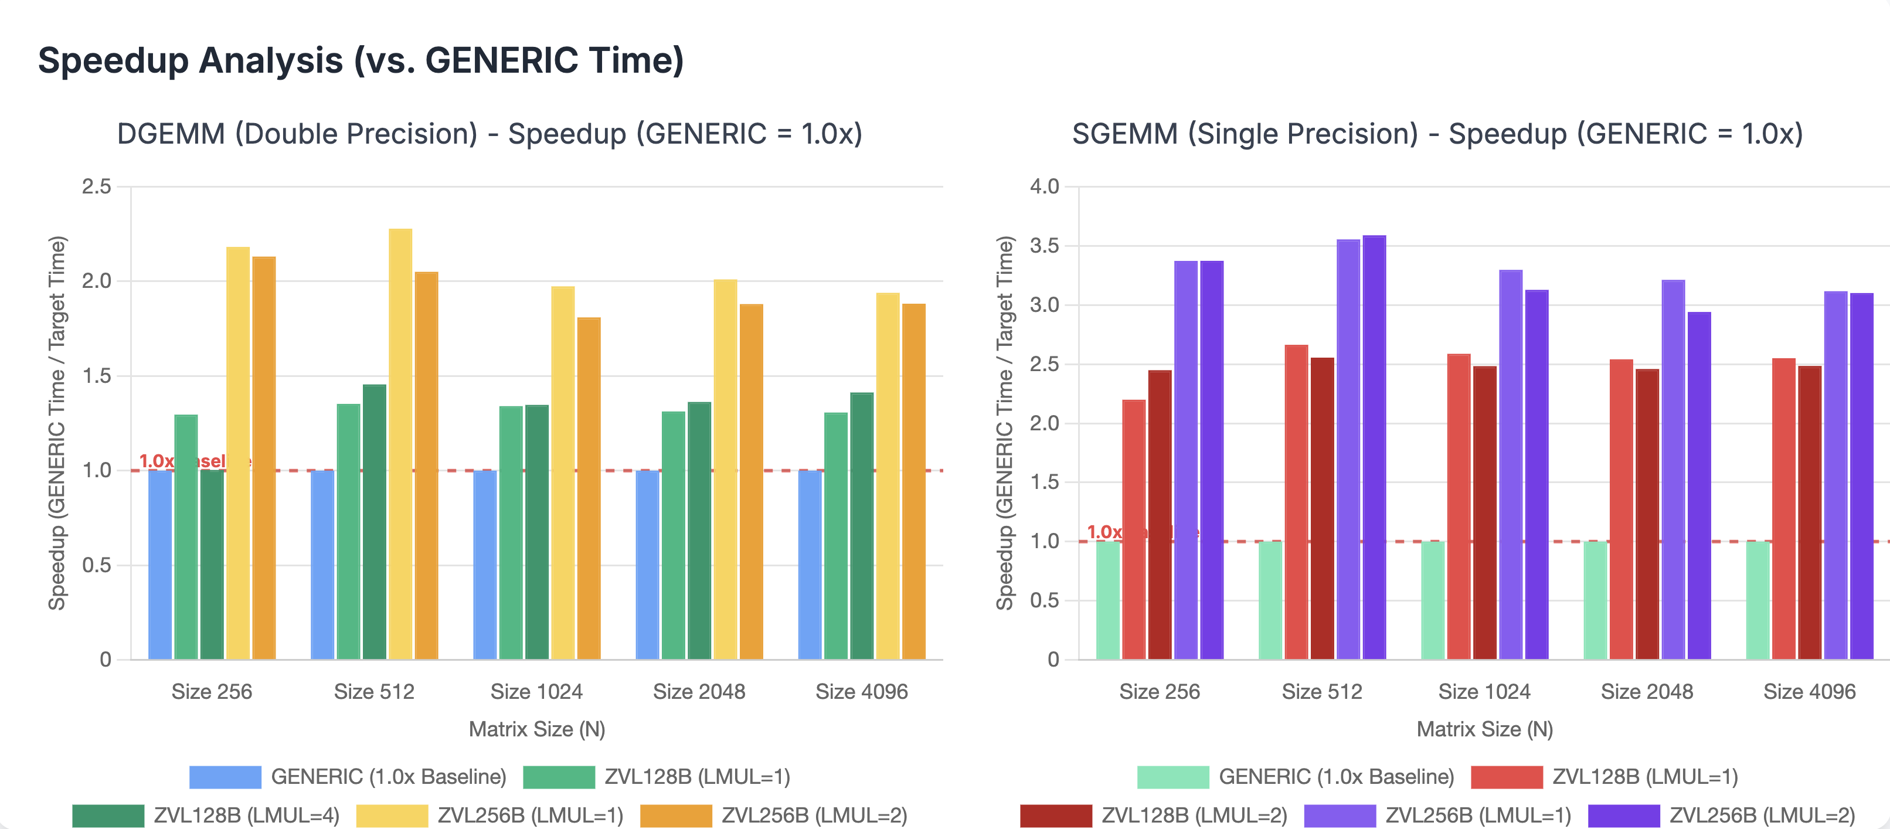
GEMM Performance Comparison & Attribution
For RISC-V, key observation points are to see what’s the impact of the two:
VLEN (Vector Length)
Wider is Better: Yes or No?
LMUL (Vector Register Grouping, aka. Length Multiplier).
How much gains can we get when increasing LMUL from 1 to 2?
Note:
GENERIC means RISC-V Scalar
ZVL128B means RISC-V Vector 128bit VLEN
ZVL256B means RISC-V Vector 256bit VLEN
For Reference, the Benchmark Testing Framework for OpenBLAS: https://github.com/docularxu/OpenBLAS/tree/working.riscv64.optimizations
Raw data and infographic published here: https://docularxu.github.io/OpenBLAS/webpages/rvv_benchmark_openblas_16Oct2025.html
Notes:
The second observation point is the usefulness of Length Multiplier (LMUL).
I’ll go the CONCLUSION first:
Vector Length (VLEN) Gain: Longer is better, But, doubling Shows Diminishing Returns
As we can see in the graph, the gains when using Higher LMUL is not linear proportional AT ALL!!!
Sometimes it’s beneficial, like where the RED arrows shows. It has positive gains.
In other times, it may have negative effects, as the YELLOW arrows show.
What that brings to us?

Slide 16
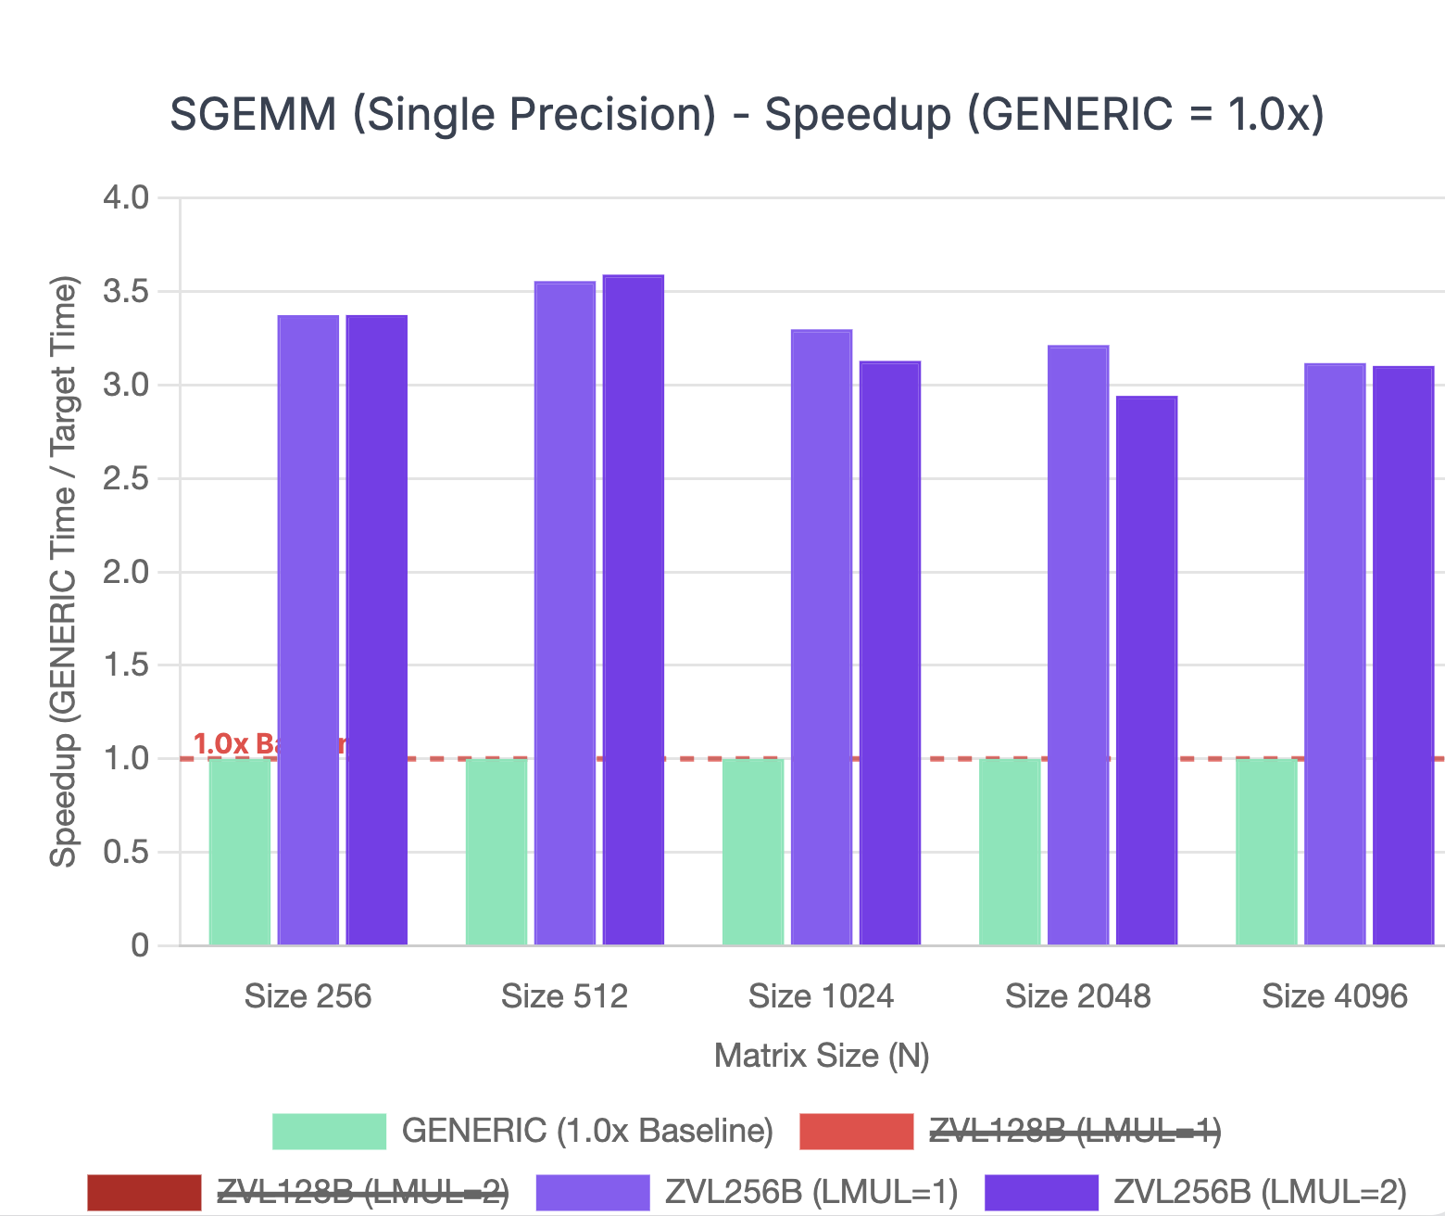
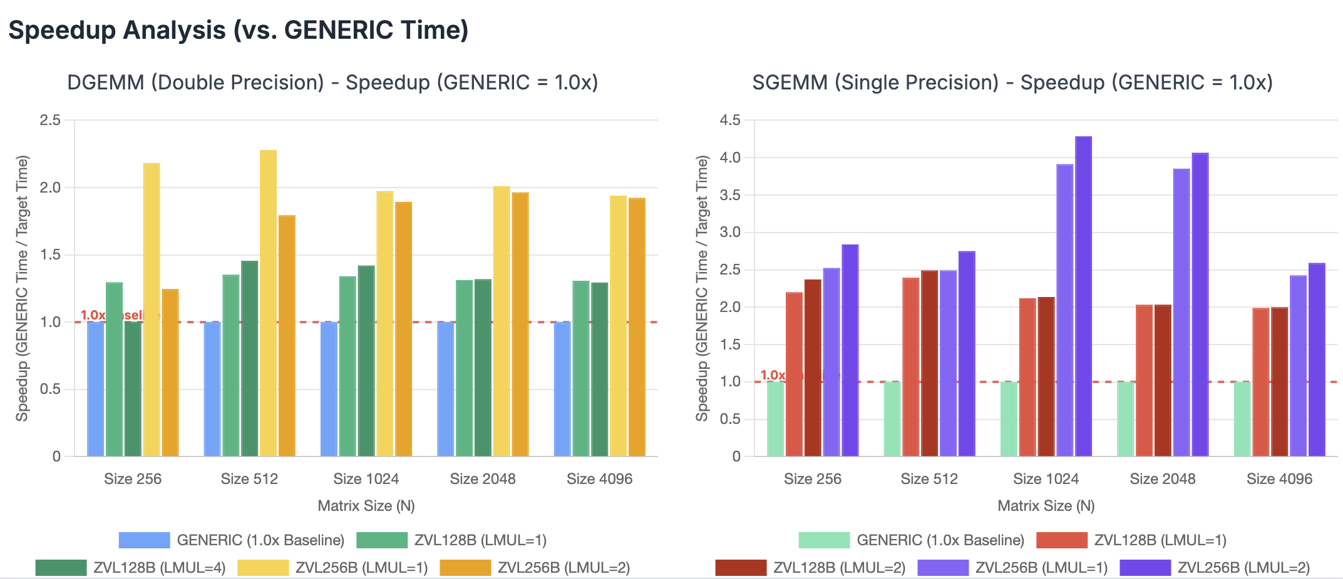
GEMM Performance Comparison & Attribution
OBSERVATAION:
For GEMM, LMUL provides minimal benefit and sometimes hurts performance
Only benefit: DGEMM on ZVL128B sees modest 8% improvement with LMUL=4, compensating for narrow 128-bit vectors
Matrix-size dependency: LMUL=2 shows 11% gain for SGEMM ZVL128B at 256×256 (22,805 vs 20,482 MFLOPS) but 3% degradation at 4096×4096 (28,696 vs 29,451 MFLOPS)
Recommendation: For production deployments on K1, use matrix-size adaptive LMUL tuning: LMUL=2 for small matrices (<1024), LMUL=1 for large matrices (≥1024), except DGEMM ZVL128B where LMUL=4 provides 8% gain
For RISC-V, key observation points are to see what’s the impact of the two:
VLEN (Vector Length)
Wider is Better: Yes or No?
LMUL (Vector Register Grouping, aka. Length Multiplier).
How much gains can we get when increasing LMUL from 1 to 2?
Note:
GENERIC means RISC-V Scalar
ZVL128B means RISC-V Vector 128bit VLEN
ZVL256B means RISC-V Vector 256bit VLEN
For Reference, the Benchmark Testing Framework for OpenBLAS: https://github.com/docularxu/OpenBLAS/tree/working.riscv64.optimizations
Raw data and infographic published here: https://docularxu.github.io/OpenBLAS/webpages/rvv_benchmark_openblas_16Oct2025.html
Notes:
For a conclusion, as recommendations, I would say,
Use ‘LMUL’ (Length Multiplier) wisely;
Matrix-size adaptive tuning is highly recommended when choosing ‘LMUL’s.
For example, in this picture, as in SGEMM:
When matrix size = 512, LMUL =2 will be preferred.
When matrix size = 1024 or bigger, LMUL = 1 will be more efficient.
Again, considering what ever the matrix size is, they all share the same sliced inner micro-kernel, the underneath reason, may be the Cache design, memory bandwidth related.
Per micro-architecture tuning will be very critical.

Slide 17

__PART IV__
Non-Linear Operator Deep Dive (SLEEF)
Notes:
Next, let’s explore the NON-LINEAR operators.
For this, my focus is in the open-source SLEEF library.

Slide 18
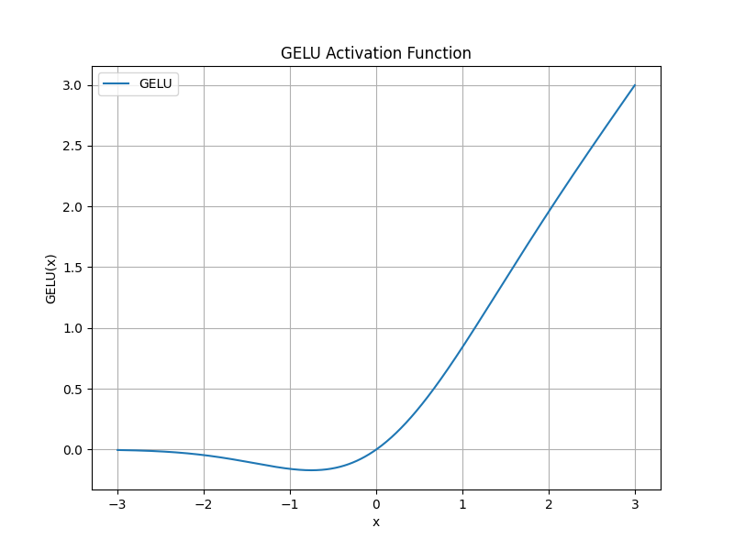
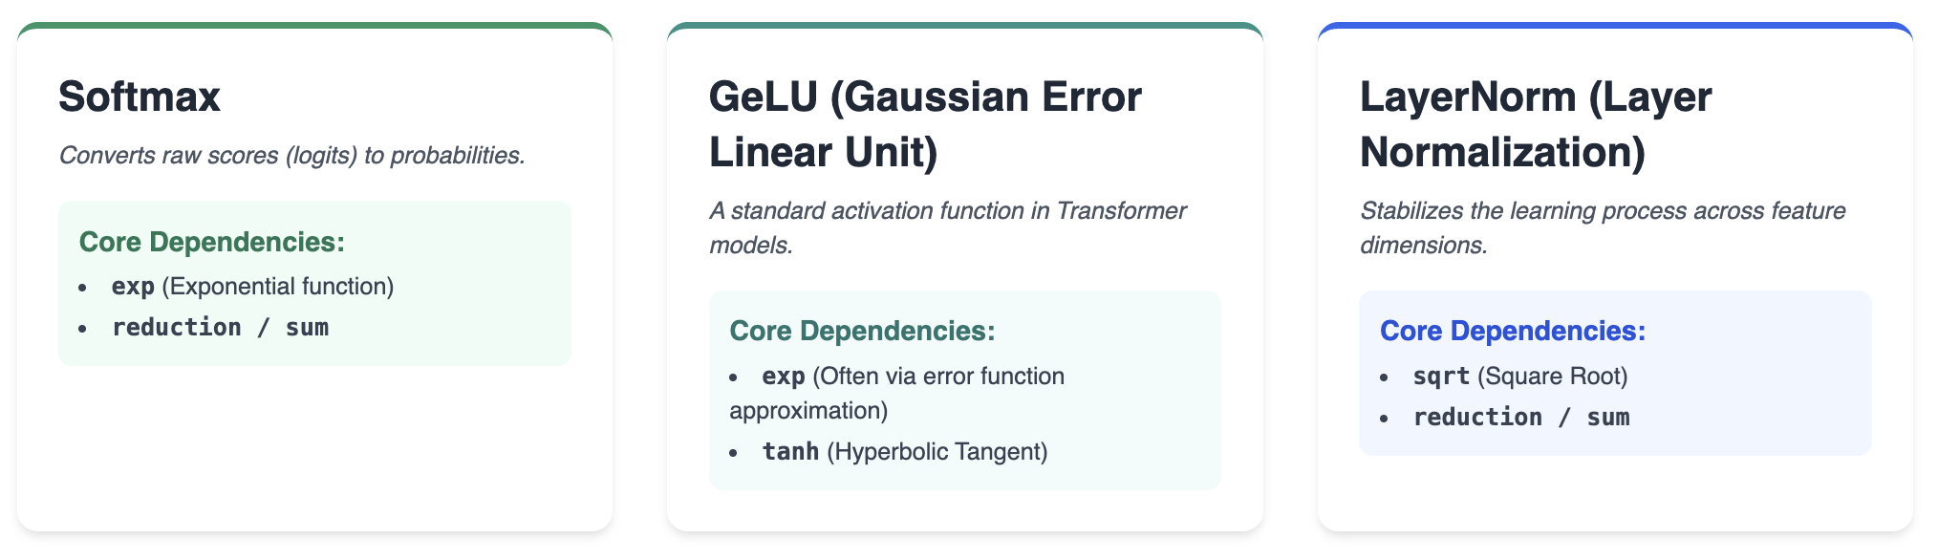
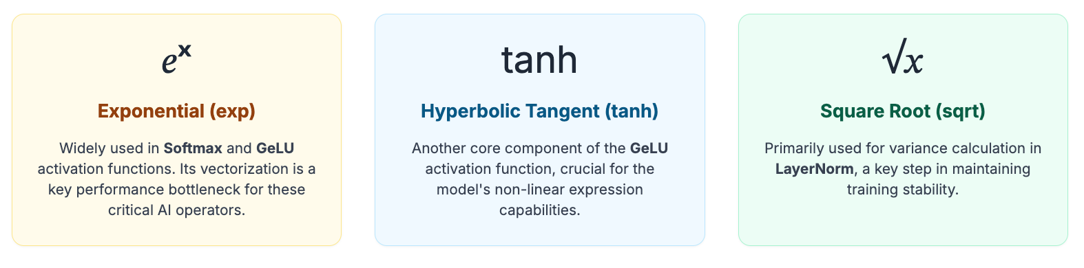
Introduction to Non-Linear Operators
Non-linear operators are essential for LLM performance, but they rely heavily on optimized standard mathematical functions (libm).
exp: (Used in Softmax, GeLU)
tanh: (Used in GeLU)
sqrt: (Used in LayerNorm)
reduction / sum: (Used in LayerNorm, Softmax)
Notes:
As said earlier, Non-linear operators contributed about 10% of the total computation in LLM inferencing.
With Activation / Normalization / Classifier functions, all belong to non-linear category.
Underlying, they can be routed to low-level mathematical calls: exponential, hyperbolic tangent, square root, and reduction.

Slide 19
Vectorizing AI Math Operators Why SLEEF?
The performance of non-linear operators like GeLU, Softmax, and LayerNorm depends on the efficient vectorization of fundamental math functions.
Core Challenge: How to apply SIMD principles to complex functions like exp, tanh, and sqrt.
The Solution: High-performance math libraries like SLEEF provide hand-tuned vector implementations of these functions for different architectures.
Our Focus: Comparing how SLEEF leverages the unique features of RISC-V Vector and other VLA platforms to accelerate these critical AI operators.
Notes:
Fortunately, there are already well-tuned Vector implementation of these math functions.
Being one of the best, there is SLEEF library.
In this talk, I will focus on:
How sleef make use of RVV vector and Length Multiplier.
I will provide a ‘GeLU’ implementation using SLEEF calls on RVV, and highlight my findings.

Slide 20
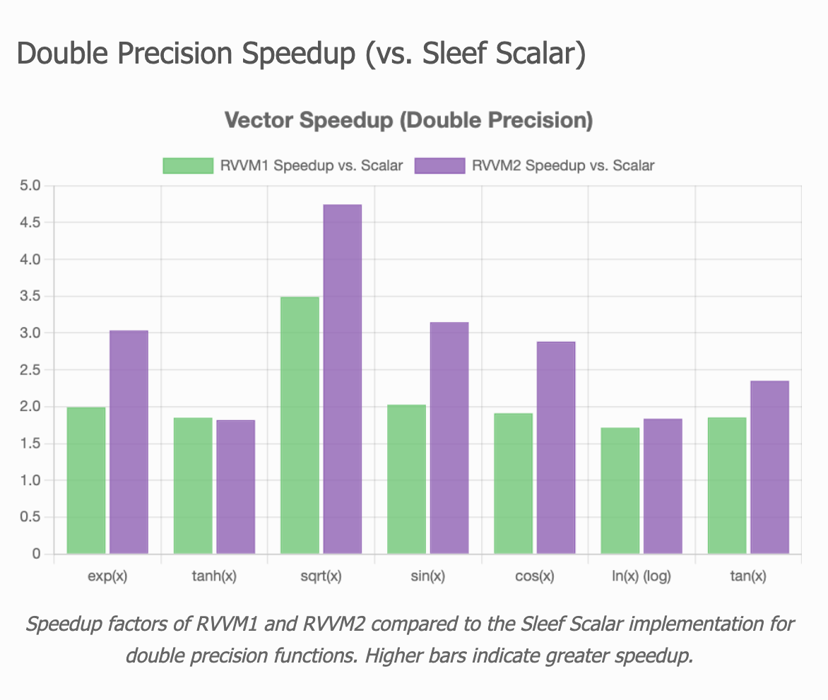
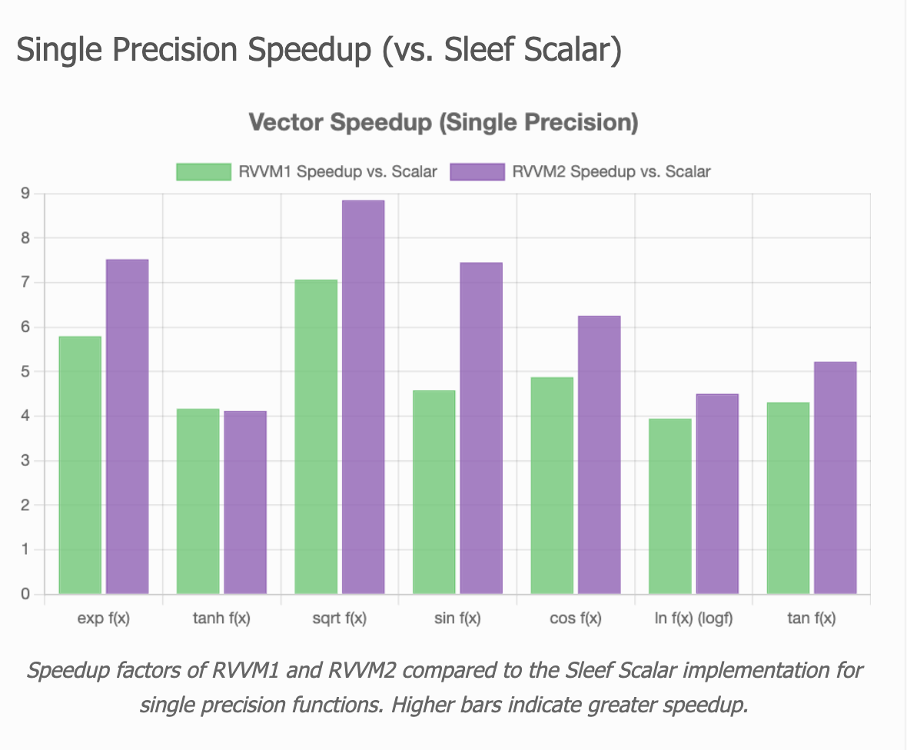
SLEEF Performance Measured (Vector vs. Scalar) Speedup Comparison
Three categories are measured:
Scalar
RVV with LMUL=1
RVV with LMUL=2
LMUL = Length Multiplier
For Reference, the Benchmark Testing Framework for SLEEF: https://github.com/docularxu/sleef/commits/working.sleef.bench/
Raw data and infographic published here: https://docularxu.github.io/sleef/webpages/rvv_benchmark_16Oct2025.html
Notes:
SLEEF is implemented in a Vector-Length Agnostic (VLA) fashion.
Which means, in Arm SVE, and in RISC-V vector, it always utilize the entire (MAXIMUM) vector lanes.
Then, in RISC-V vector, because we have ‘Vector Register Grouping’, aka. Length Multiplier, the story becomes more instresting.
Here, actually, in SLEEF, there are two variants: RVVM1, RVVM2.
Meaning LMUL=1 and LMUL=2 respectively.
Actually, what we saw here is using a bigger LMUL is always GOOD!!
The only outlier is ‘tanh(x)’.
All everything else others, shows increase in speedup when LMUL grows from 1 to 2.
== END ==
(no time to compare this) Theoretical maximum speedup is, K1 VLEN=256-bit:
Double: 4x for RVVM1; 8x for RVVM2
Single: 8x for RVVM1; 16x for RVVM2

Slide 21
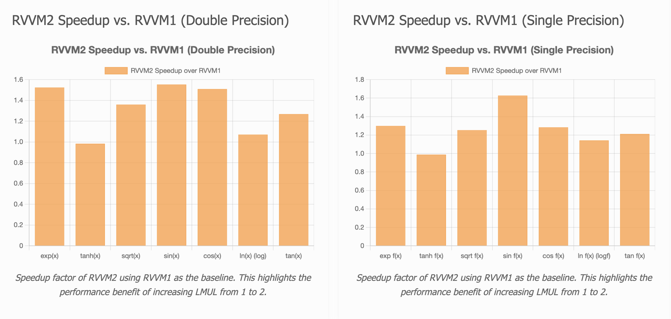
SLEEF Performance Measured (LMUL = 2 vs. LMUL = 1 ) RVVM2 Gain Over RVVM1
RISC-V provides a powerful feature not found in SVE: Vector Register Grouping (LMUL, ie. Length Multiplier). This allows software to logically combine multiple registers to operate on wider data or reduce loop overhead.
Three categories are measured:
Scalar
RVV with LMUL=1
RVV with LMUL=2
SLEEF Config | Description | Relative Performance
RVVM1 (LMUL=1) | Standard, one register per operation. | 1.0x (Baseline)
RVVM2 (LMUL=2) | Groups two registers | ~1.4x Caution: tanh(x) sees no gains when growing LMUL
For Reference, the Benchmark Testing Framework for SLEEF: https://github.com/docularxu/sleef/commits/working.sleef.bench/
Raw data and infographic published here: https://docularxu.github.io/sleef/webpages/rvv_benchmark_16Oct2025.html
Notes:
Here is a graph showing this trend more clearly:
Let’s directly compare gains of LMUL =2 against LMUL =1,
We saw steady ~1.4x speed up in RVVM2 (ie. LMUL=2).
This is super-good. At the same time, fine-tuning over LMUL maybe required. As we saw, there is no GAINs in ‘hyperbolic tangent’ function.
Since these are memory-bound operators, the limitation is not in the register file numbers side.
For our next step, it is logical to explore:
Does it make sense to go even higher to squeeze more performance from LMUL?
For example, Does RVVM4 ( LMUL=4 ) make sense?
That will be our future exploration directions.

Slide 22
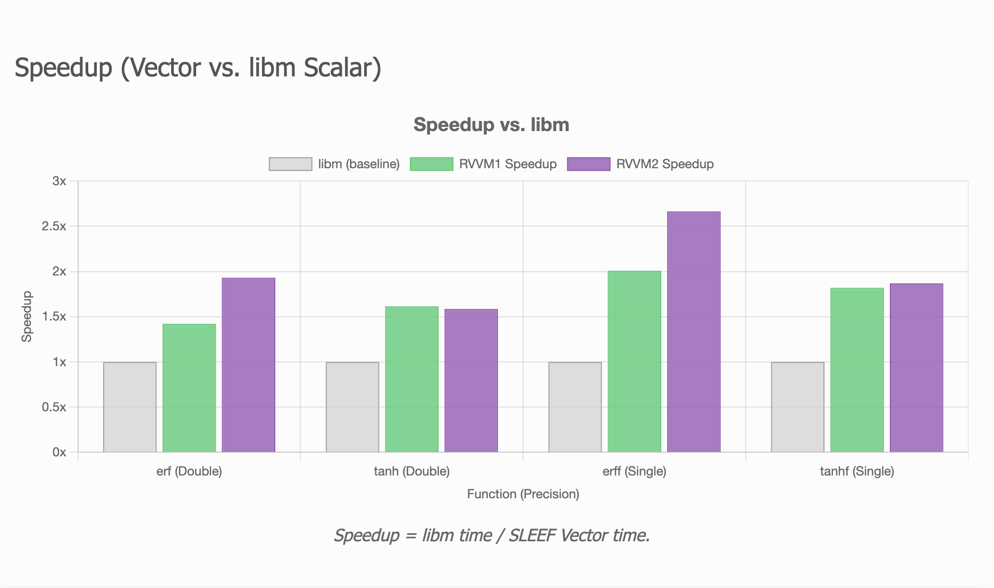
SLEEF Performance Measured (LMUL = 2 vs. LMUL = 1 ) GeLU on RISC-V
Comparison of libm scalar vs. SLEEF vector implementations in GeLU.
Scalar
RVV with LMUL=1
RVV with LMUL=2
GeLU Kernel Using RVV
SLEEF Configuration | Relative Performance
Libm (scalar) | 1.0x (Baseline)
RVVM1 (LMUL=1) | 1.5x sppedup
RVVM2 (LMUL=2) | ~2.0x speedup
For Reference, the Benchmark Testing Framework for SLEEF: https://github.com/docularxu/sleef/commits/working.sleef.bench/
Raw data and infographic published here: https://docularxu.github.io/sleef/webpages/rvv_benchmark_gelu_17Oct2025.html
Notes:
So, let’s get to a more real use case. Let’s use the base math functions in SLEEF to implement a real GeLU (ACTIVATION) function.
GeLU has two implementation methods, One the exact version is using the "error function”, ERF(); the other is using ‘hyperbolic tangent’ TANH() approximation.
1. Exact version: GELU(x) = 0.5 * x * (1 + erf(x/√2))
2. Tanh approximation: GELU(x) ≈ 0.5 * x * (1 + tanh(√(2/π) * (x + 0.044715 * x3)))
Conclusion / Observations:
1. RVVM2 is better than RVVM1.
2. the ‘Error Function’ erf() is more friendly to Length Multiplier (LMUL) expansion.
3. Bottom line: SLEEF RVV delivers solid gains, with RVVM2 reaching up to ~2.66x (erff) over libm.

Slide 23
__PART V__
Tools and Toolchains
Notes:
As the final part of my talk, I would like to touch a little bit of ‘tools and SYSTEM OBSERVABILITY’.

Slide 24
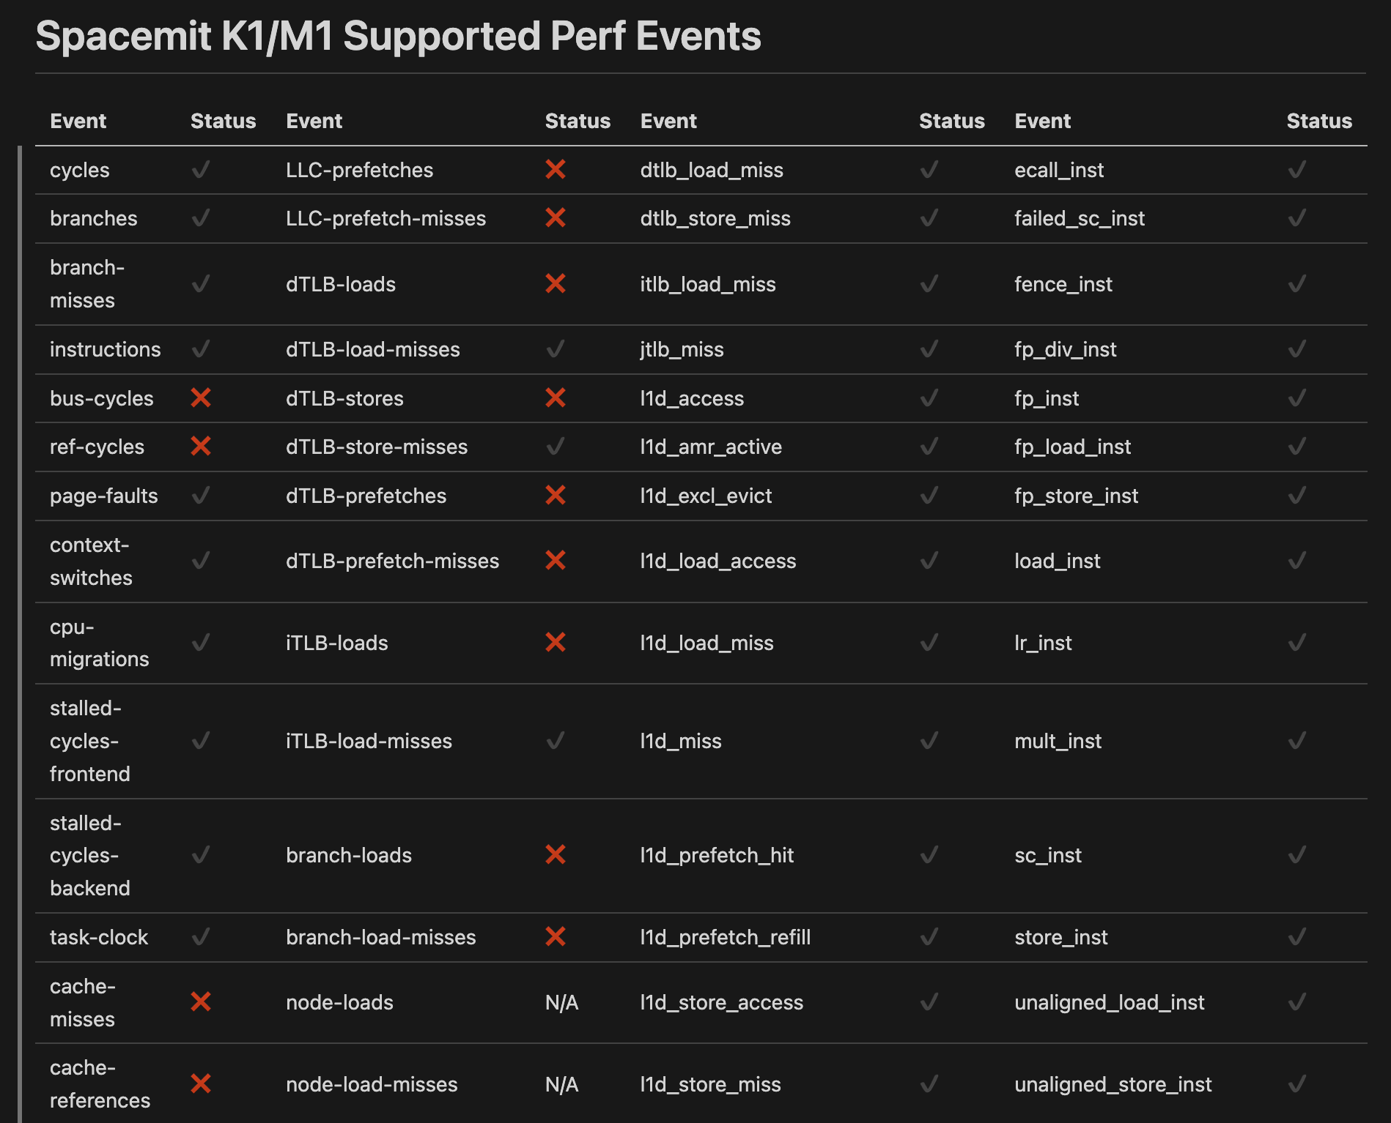
Tooling & Observability
Performance Monitoring (perf):
RISC-V Platform (K1): Support is available in their vendor tree. Refer to:
https://bianbu.spacemit.com/en/development/perf/
The SpacemiT K1 provides some essential events, but the ecosystem is still evolving. Not upstreamed.
Improving perf support is a key area for community contribution.
Examples:
(Right) K1 proprietary/vendor-specific events
vs.
(Left) the Linux common events
Notes:
In the hardware platform we use, the SpacemiT K1, it has a customized ‘vendor proprietary’ perf support.
It provides a plenty of events. (Total account is 82 events).
However, in order to use them, you have to migrate their ‘vendor’ version of Linux kernel (currently v6.6),
And compile the vendor version of ‘perf’.
All these add to barriers for performance tuning. Making the method non-standard.
Again, as mentioned by many other speakers today, I call for ecosystem collaboration. In the ‘perf’, in system observability.
Click for next page!

Slide 25
Summary & Call to Action
Optimize with the RISCstar Toolchain
Built by experts with cross-architecture fluency, our toolchain is finely tuned for maximum performance on RISC-V Vector hardware.
Explore Now:
https://riscstar.com/toolchain/
Key Takeaways from Our Porting Journey:
Master VL Control: For compute-bound tasks, data locality is king. Don't chase maximum LMUL. Use RVV's vsetvl to manually craft small VL loops that fit the L1 cache, just as OpenBLAS does.
Leverage the Math Libraries: Don't reinvent the wheel for non-linear functions. Use and contribute to libraries like SLEEF. Improving these libraries is the fastest path to unlocking RVV's performance for AI workloads.
Embrace Observability: Trust, but verify. Use perf and analyze the generated assembly to ensure your VL settings, tail policies, and memory accesses are what you expect.
Engage with the Ecosystem: RISC-V's greatest strength is its community. Submit patches and provide feedback to upstream toolchains like LLVM and GCC. Every improvement benefits everyone.
Notes:
Data Locality! Length Multiplier!
Not always good, but it can be always good.
Fine-tuning is the king
Ecosystem maturity:
The ‘Cache Block Prefetch Extension’ support, in OpenBLAS, in compilers.
The tooling, observability, like ‘perf’ support. We need a common RISC-V arch-wise solution, instead of ‘vendor-specific’ designs.
At last, let’s unify around the ‘RISCSTAR TOOLCHAIN’, come and join us! Download and use it~

Slide 26
Connect with me:
GUODONG XU
EMAIL: guodong@riscstar.com
LINKEDIN: https://www.linkedin.com/in/docularxu/
GITHUB: https://www.github.org/docularxu
THANK YOU!
Notes:
With that, I wrap up today’s talk!
Thank you.

Slide 27
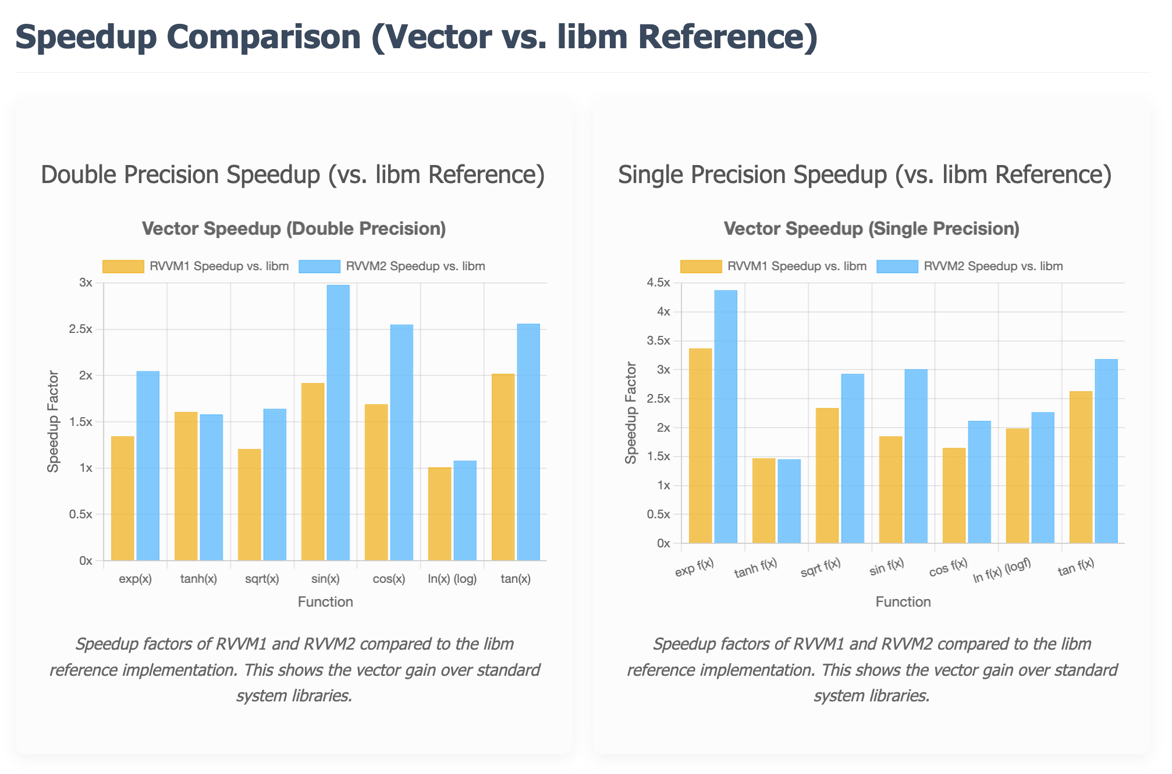
SLEEF Performance Measured (Vector vs. Libm reference) Speedup Comparison
Three categories are measured:
Libm Reference
RVV with LMUL=1
RVV with LMUL=2
LMUL aka. Length Multiplier
For Reference, the Benchmark Testing Framework for SLEEF: https://github.com/docularxu/sleef/commits/working.sleef.bench/
Raw data and infographic published here: https://docularxu.github.io/sleef/webpages/rvv_benchmark_16Oct2025.html

Slide 28
The OpenBLAS SVE Strategy: Predicate-Driven VL-Agnosticism
The SVE implementation reflects the architecture's design for flexibility and a mature ecosystem.
Core Mechanism: Predication.
Implementation: SVE kernels naturally handle variable data lengths using whilelt loops and svcnt functions, making the code inherently VL-Agnostic.
DYNAMIC_ARCH & Targeted Optimization:
OpenBLAS uses runtime dispatch to select the best SVE path for specific cores like Neoverse V1/V2 or A64FX.
GEMM Fine-Tuning:
While BLAS1/2 benefit fully from the VL-Agnostic model, high-performance GEMM micro-kernels are still fine-tuned for the L1 cache shapes of specific SVE cores.
Key Difference: The code itself remains VL-Agnostic and runs correctly on any SVE length. It does not require hardcoding a small, fixed VL in the implementation, unlike the RVV strategy for peak performance.

